Slide 1




Scaling geospatial processes on Harvard’s high-performance cluster
Devika Kakkar and Ben Lewis
Harvard Center for Geographic Analysis
Datafest 2020
Harvard University, January 21st

Slide 2

“Big” geospatial data: even a million features
Most sets of geographic features are modest: thousands to millions in size. But...
Increasing spatial resolution is changing this: e.g. National Hydro Datasets Medium Res -> ~3M reaches, High Res -> ~30M reaches. Similar for gridded data, e.g. 10m DEM -> 1m Lidar-based 3DEP increases volume 100x.
Time is changing this: multiple observations and predictions for multiple feature properties quickly combine into billions of records.
Traditional GIS software struggles to access and visualize, let alone analyze such scales and structures of datasets.
Datasets with 1-100 billion records are becoming common in academic, business, and government domains
Notes:
Most of Gis data is thousands to millions
Increasing spatial resolution is changing this
Time is changing this: Multiple observation and predctions for multiple features properties quickly combine into billions of records
Traditional GIS software struggles to access and visualize let alone analyze
Dataset with 1-1000 billion records are becoming common in academics

Slide 3
FAS Research Computing (FASRC)
FAS Research Computing offers:
Supercomputing Environment (Cannon HPC Cluster)
Lab Storage
Instrument Computing Support
Hosted Machines (Virtual and Physical)

Slide 4
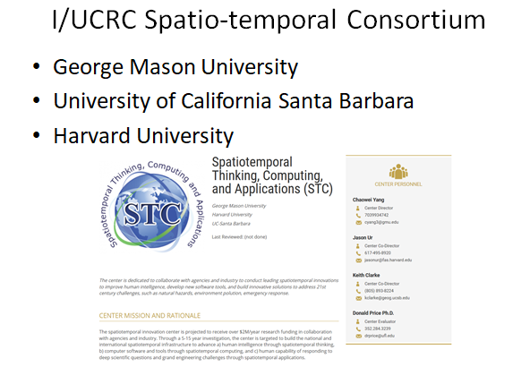

Slide 5
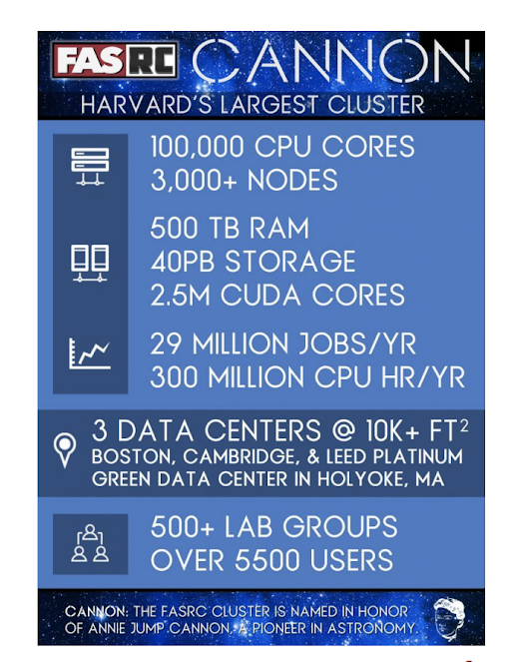
Supercomputing Environment: Cannon [1]
Compute: 100,000 compute nodes, 8-64 cores/node, 12Gb to 512Gb memory/node, 2,500,000 NVIDIA GPU cores
Software: CentOS 7 operating system, Slurm job manager, Singularity, 1000+ scientific tools and programs
Storage: 100 GB (Home dir), 4TB+ (Lab storage), 70Gb/node (Local scratch), 2.4PB (Global scratch), 3PB (Persistent Research data)
#144 in TOP500 Supercomputers in world
Cannon Cluster [1]

Slide 6
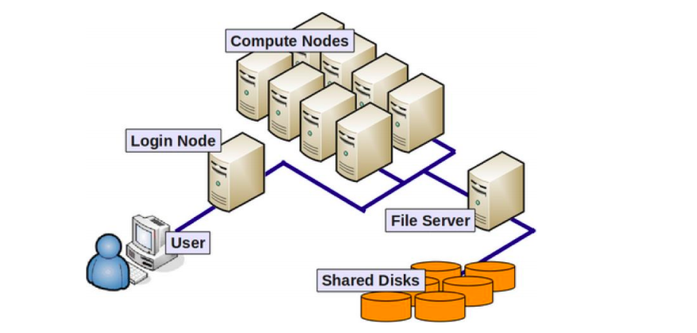
Cluster Basics
Basic Architecture of FASRC Cluster [1]

Slide 7
Slurm Workload Manager
Slurm is an open-source cluster management and job scheduling system for Linux clusters
Slurm is the workload manager on about 60% of the TOP500 supercomputers.
It performs the following key functions:
Allocates resources
Provides a framework for managing jobs
Resolves conflicts for resources
FASRC uses Slurm to manage workload on the Cannon cluster

Slide 8
Slurm scheduler
FASRC uses Slurm built-in job accounting and fairshare system to ensure that resources are used fairly
Every lab has a base Share of the community-wide system
Fairshare score of a lab is then calculated based off of their Share versus the amount of the cluster they have actually used
Fairshare score is then utilized to assign priority to their jobs relative to other users on the cluster
TRES: allows the scheduler to charge back users for how much they have used different features on the cluster
sshare: A tool that can be used to see your current fairshare

Slide 9
Singularity on the cluster
Singularity is a free, cross-platform and open-source technology used for containerization of workloads
As of 2018, the Singularity user base is estimated to be greater than 25,000 installations and includes users at academic institutions such as Ohio State University, and Michigan State University, as well as top HPC centers like Texas Advanced Computing Center, San Diego Supercomputer Center, and Oak Ridge National Laboratory.
Singularity has been deployed on FASRC cluster
Singularity enables users to have full control of their operating system environment
FASRC uses Singularity instead of Docker for security reasons
Singularity can import Docker containers

Slide 10
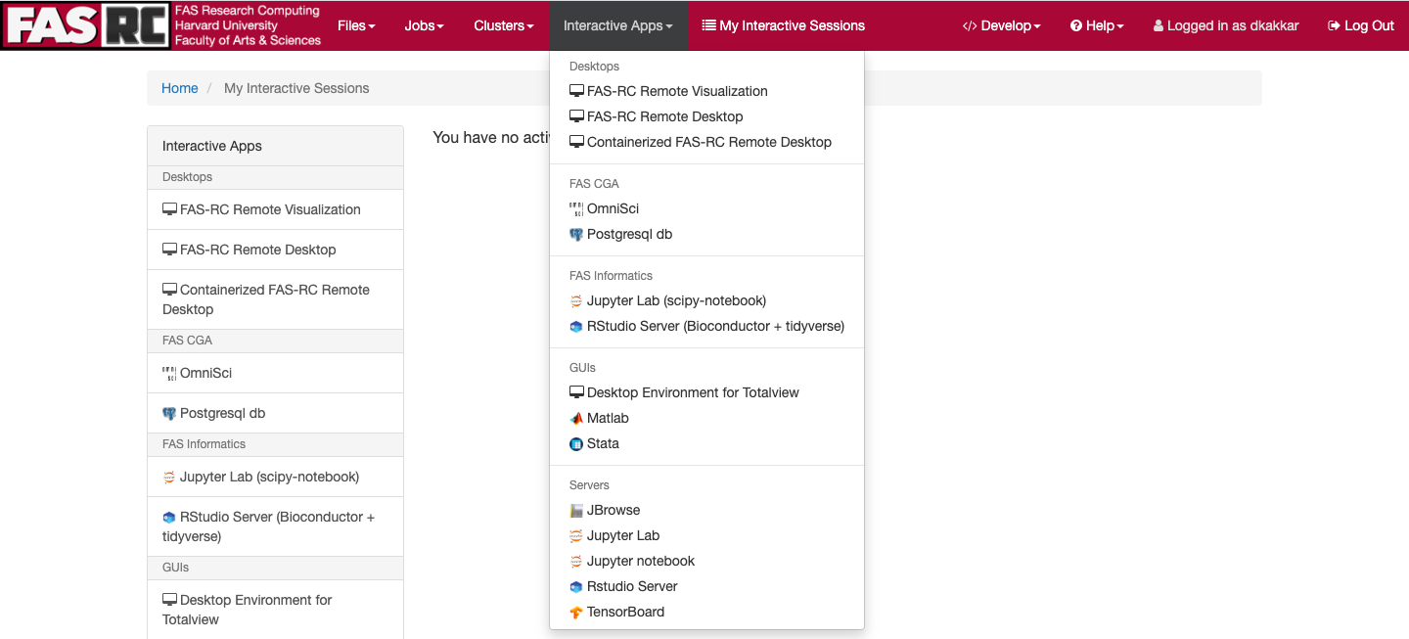
Data Science apps on FASRC

Slide 11
GIS Databases for Big Data
PostGreSQL: Powerful, open source object-relational database system
PostGIS: Provides spatial objects for the PostgreSQL database, allowing storage and query of information about location and mapping
OmniSci:
Designed to overcome the scalability and performance limitations of legacy analytics tools
Super fast queries/analytics (including machine learning) of unindexed data (open source)
Super fast interactive rendering (free for educational use) of millions or billions of features, on-the-fly on a map
Leverages the massively parallel processing of GPUs alongside traditional CPU compute

Slide 12
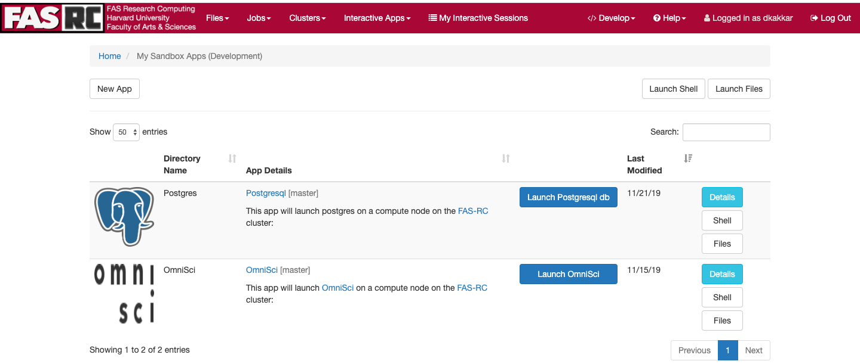
GIS apps that will be available in the future

Slide 13
GIS Apps on FASRC
An app on FASRC remote desktop vdi.rc.fas.harvard.edu to run the server
Code for the app will be in user home folder
The apps in the personal ~/fasrc/dev/ folder will show up in the "Develop" menu and under "My Interactive Sessions" once you login to vdi.rc.fas.harvard.edu
One can launch the app, and upon successful start of the job, on the dashboard you will get info on how to connect
The location where the job is staged and the log is stored is reachable clicking next to "session ID"
To make changes in that app,create a branch, make changes and we can then merge it
Github repo: https://github.com/cga-harvard/OmniSci_on_HPC

Slide 14
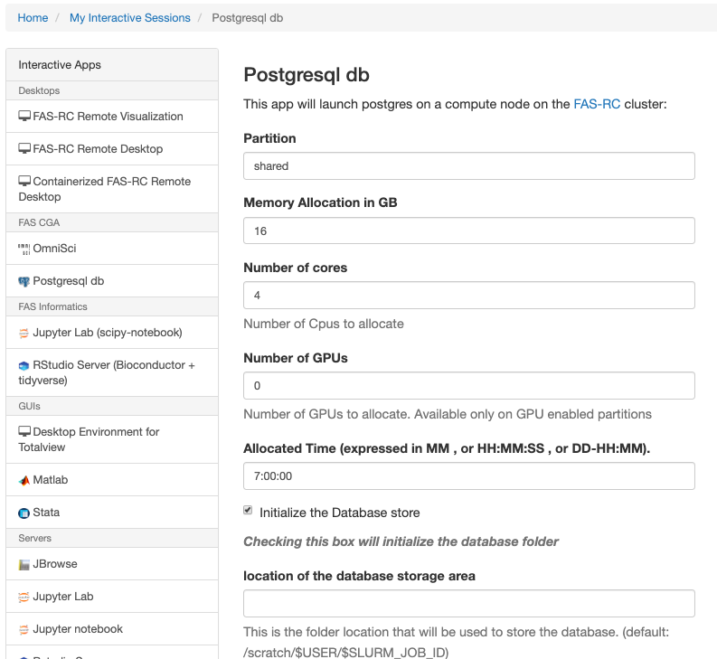
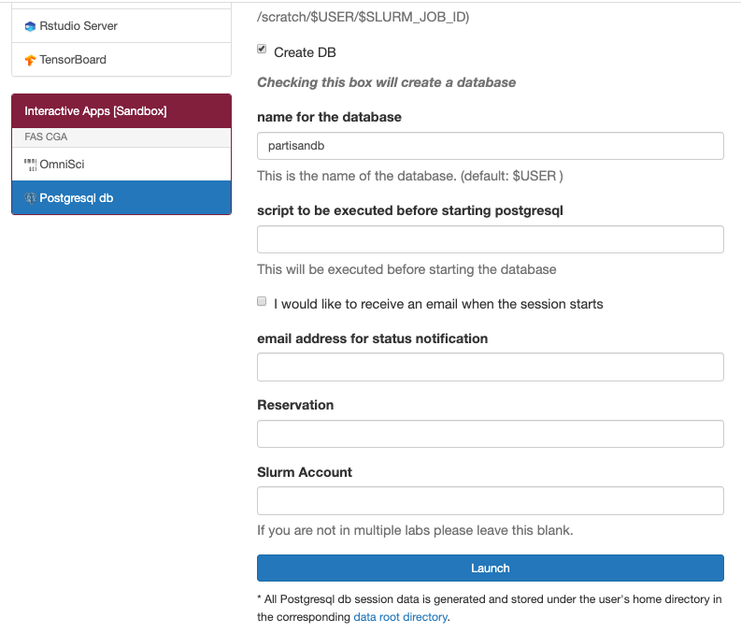
POSTGRES on FASRC

Slide 15
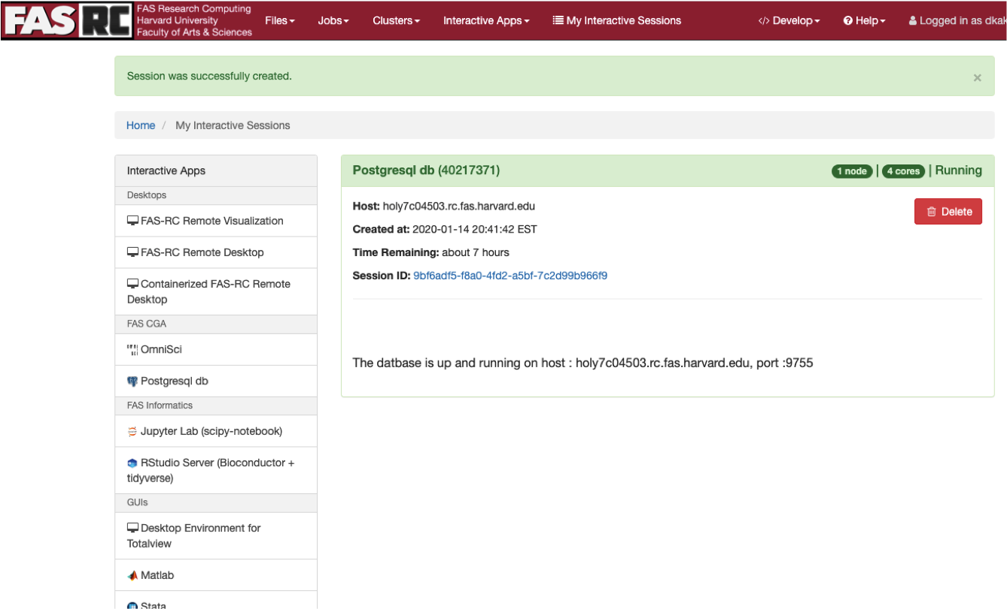

Slide 16
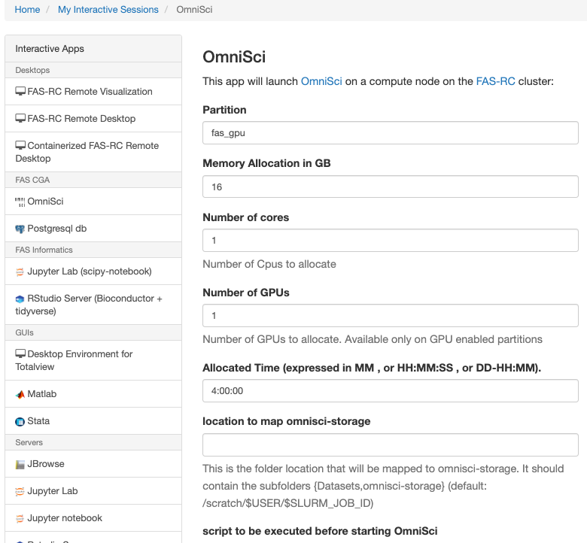
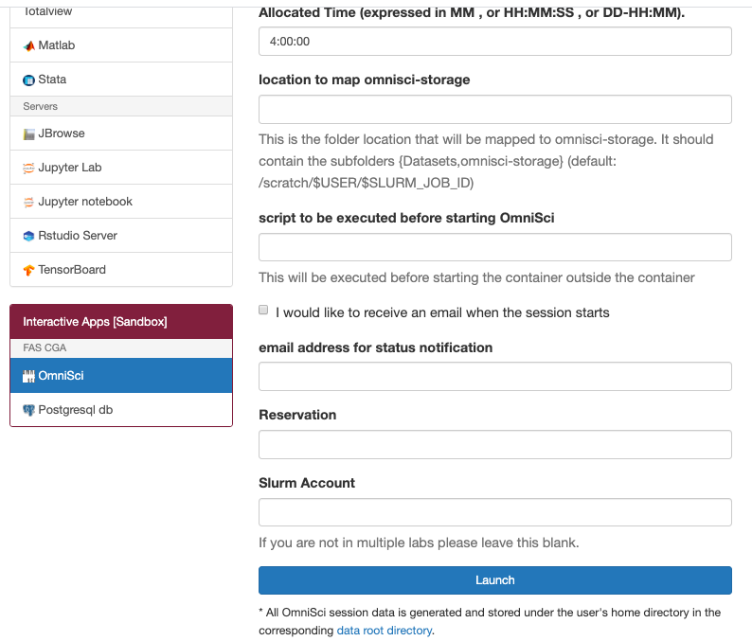
OmniSci on FASRC

Slide 17
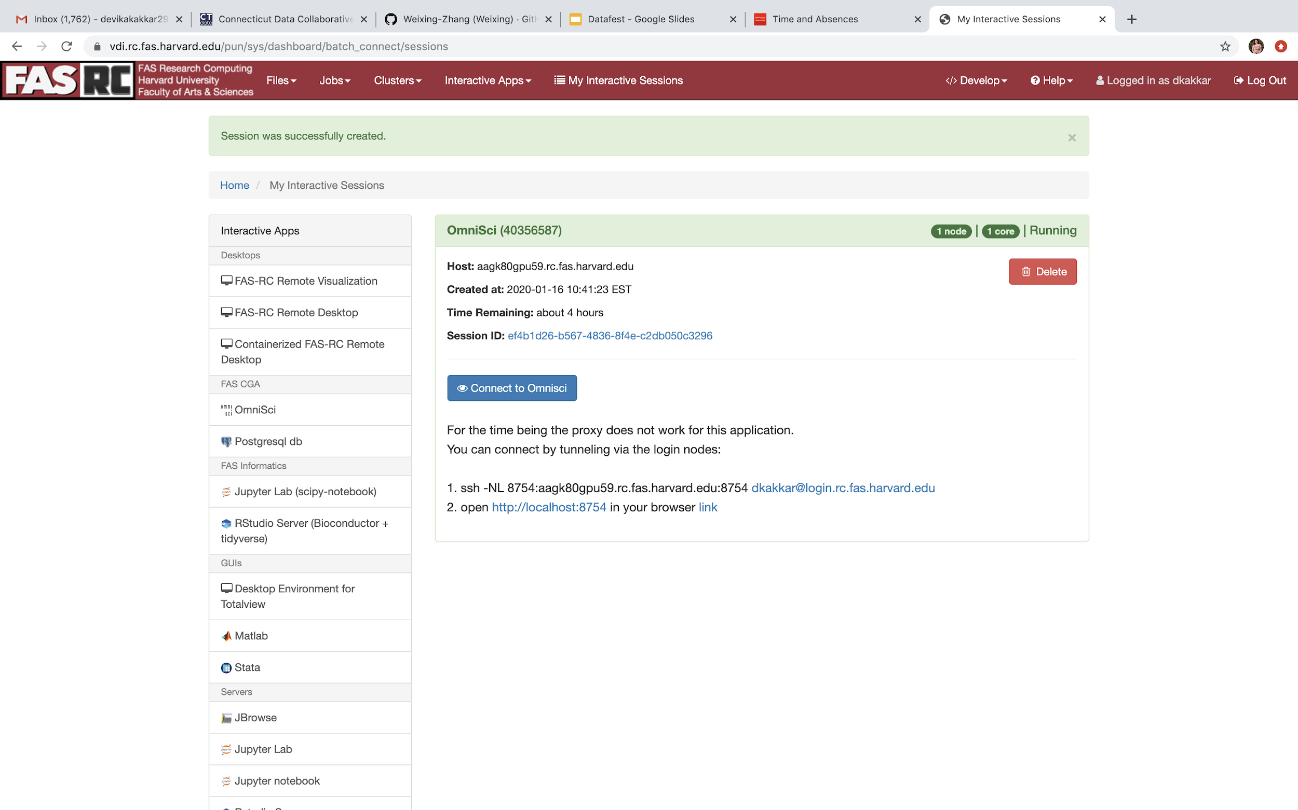
OmniSci on FASRC

Slide 18
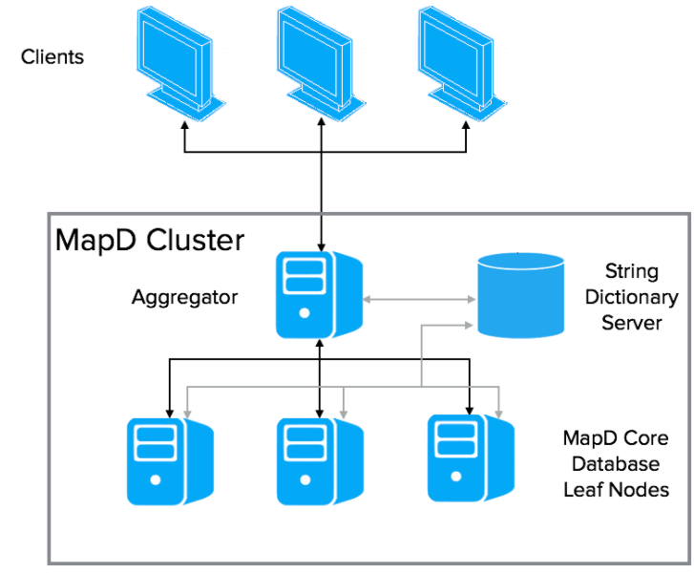
Distributed OmniSci on FASRC
Distributed Configuration OmniSci [5]

Slide 19
Illustrative Use Case

Slide 20
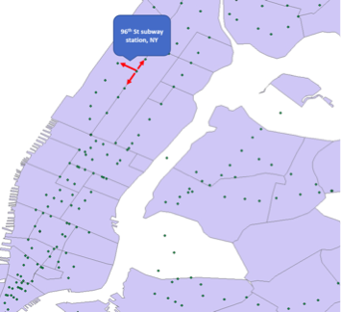
Problem Introduction
K Nearest Neighbor (KNN) calculation is a well known GIS operation which is hard to scale
The three common methods of finding KNN:
Traditional algorithms
Geohash based KNN
Index-based Search

Slide 21
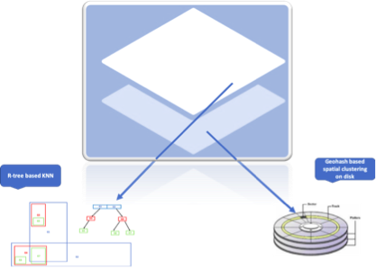
Geohash Clustering with KNN search
Combining two popular spatial index for best results: Geohash and R-tree
A two layer approach:
Bottom layer : Geohash index based clustering
Top layer: R-tree index based searches
Extremely fast: 200,000 distance calculations per second
On moderate resources: m4.xlarge EC2 with 300 GB EBS
Cost efficient: $175/month

Slide 22
Use Case: Partisan Analysis
Construct individual levels of partisan exposure at several approximated geographies for each voter in US
Performing k-means clustering on a voter dataset of 180 million, with k=1000
Solution wrapped as Amazon AMI for easy and fast implementation
AMI replicates the entire KNN computation environment on launch
User friendly solution with no GIS expertise needed
Results stored as PostGIS dumps on S3 in instead of EBS
87% compression in the result dataset obtained
18TG of DB reduced to 1500 GB
Storage cost reduced form $1800/month to $35/month (98% reduction)

Slide 23
Objective
The main objective of this work are as follows:
To make k-means calculations against large datasets fast and easy
A variation on our approach could likely be used to speed up other spatial processes which require neighborhood search operations

Slide 24
Related work elsewhere
Another way of calculating KNN on a big dataset is distributed processing on Spark using scikit-learn, however:
Spark’s MLlib doesn’t have built-in support for KNN calculations, but scikit-learn does
scikit-learn’s k-NN kneighbors() method is a computational bottleneck for large datasets and needs parallelization.
scikit-learn’s k-NN kneighbors() is inserted into a Spark map function and run in a distributed environment

Slide 25
How ours is different
Extremely Fast: 200,000 distances/sec
Resource Optimized: Basic EC2 m4.xlarge server
Two layered approach:
Bottom layer of Geohash based clustering assisting fast data retrieval by the
Top layer of R-tree based KNN search
Dimensional reduction: 2D coordinates reduced to 1D Geohash providing compressed storage
Cost Effective: Infrastructure costs only $175/month
Hardware and Software Optimization: Optimization of search algorithm and hard disk storage
Customized AMI: Ready to use
Compressed Storage: 18 TB reduced to 1.5 TB
GPU based: Extremely fast GPU based processing of results

Slide 26
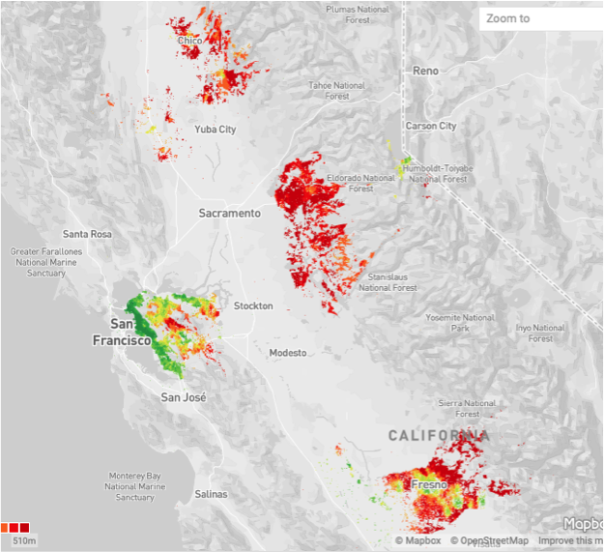
Related work using OmniSci
Challenge: Processing 180 billion distances to calculate the partisan weights of each voter
Goal: Minimize overall time for geospatial analysis of big data
Method: Use GPUs instead of CPUs
Platform: OmniSci
Real time interactive visualization
Time and cost saving over traditional approach

Slide 27
Solution using FASRC
AWS setup is efficient but expensive to use long term
FASRC provides a more sustainable long term solution
Our plan is to install PostGIS and OmniSci as public apps on the FASRC cluster
Thereafter, transfer the PostGIS based KNN solution to FASRC
Transfer Omnisci based modelling solution to FASRC
I/O is a big overhead in problems of these scales so loading the data once and utilizing it over and over again makes it more efficient
Divide and Conquer approach: Currently, multiple AWS instances are launched using the AMI to replicate the database over multiple instances and hence save I/O time
Replicate AWS: Run several asynchronous jobs on FASRC which will run independent calculations and then combine the results in the end

Slide 28
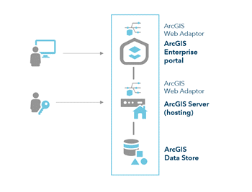
Future Plans
Installing ArcGIS Enterprise which consists of:
ArcGIS Enterprise Portal
ArcGIS Server
ArcGIS Data Store
Exploring other possible use cases such as:
Disease Surveillance
Global Internet access mapping
National Water Model
EPA Air Quality Modeling
Buying paid infrastructure on FASRC for hosted apps
ArcGIS Enterprise [4]

Slide 29
References
[1] Introduction to Cluster Computing: https://www.rc.fas.harvard.edu/wp-content/uploads/2019/12/Intro-to-Cannon.pdf
[2] Postgis- https://postgis.net/
[3] Slurm Workload Manager: https://slurm.schedmd.com/overview.html
[4] Singularity on Cluster: https://www.rc.fas.harvard.edu/resources/documentation/software/singularity-on-the-cluster/#odyssey
[5] OmniSci Overview: https://docs.omnisci.com/latest/4_distributed.html
[6] ArcGIS Enterprise: https://enterprise.arcgis.com/en/documentation/install/
Evaluation: http://bit.ly/datafest_eval

